Slide 1

By Devyani Kadam
Business Analyst Career Program - Capstone Project

Slide 2

Agenda
Data Exploration
Statistical Analysis using Excel
Graphical Analysis using Excel
Insert the given data into the SQL server
Import the Data from the SQL Database into PowerBI
Interactive Dashboard by using visualization tools
Conclusion and Inferences
Endnotes

Slide 3
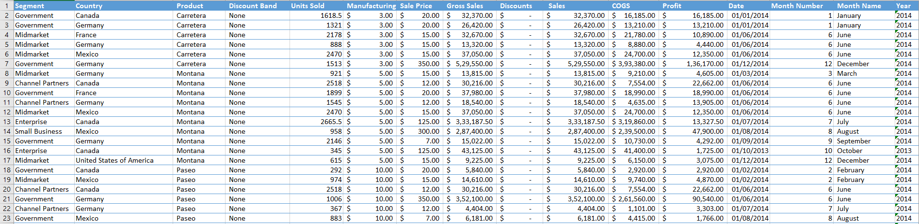
Data Exploration The given data shows “Western financial data”. The country wise segment with include product,discount band,Unit sold,Manufacturing,Sale Price,Gross sales,Discounts,Sales,COGS,profit,date and month number,month name and Year

Slide 4
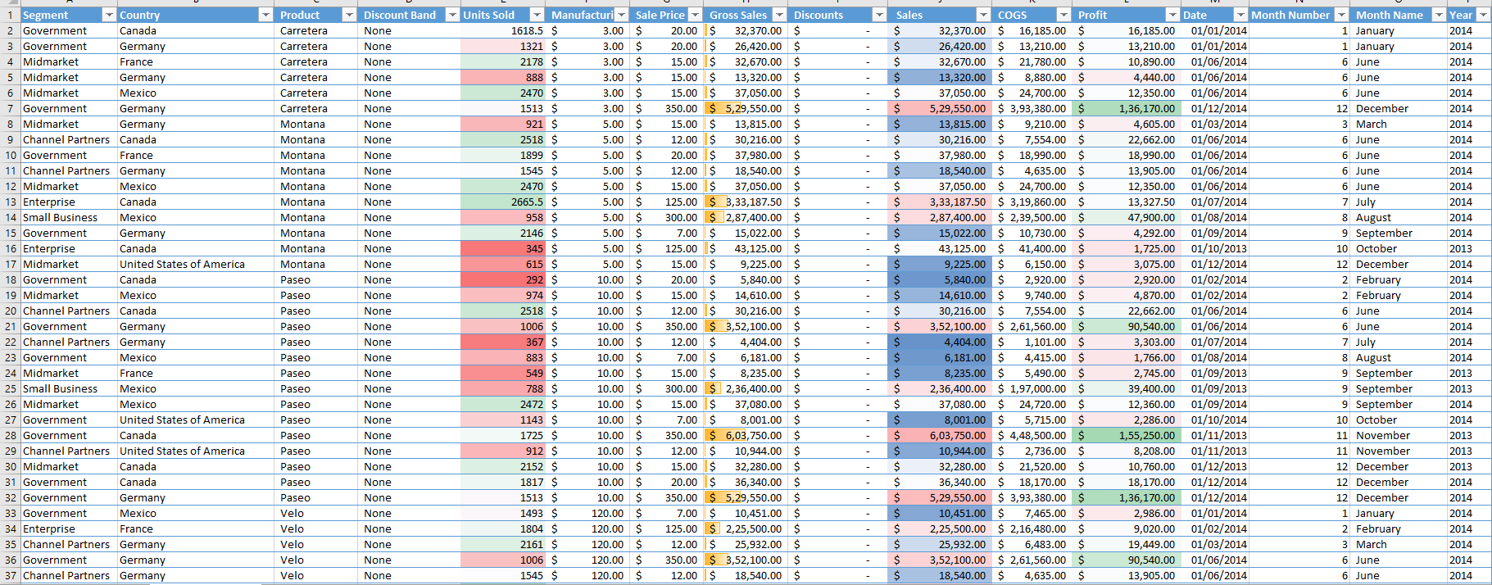
Data Cleaning Data cleaning is done on given data by applying filter and formating the sheet .

Slide 5
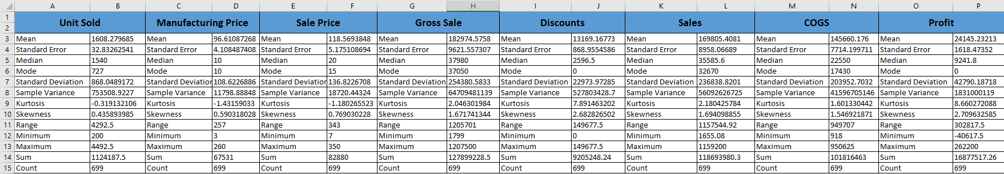
Statistical Analysis using Excel
Descriptive statistic performed on dataset to describe the basic features of the data. It provides information on summary statistics that includes Mean, Standard Error, Median, Mode, Standard Deviation, Variance, Kurtosis, Skewness, Range, Minimum, Maximum, Sum, and Count.

Slide 6
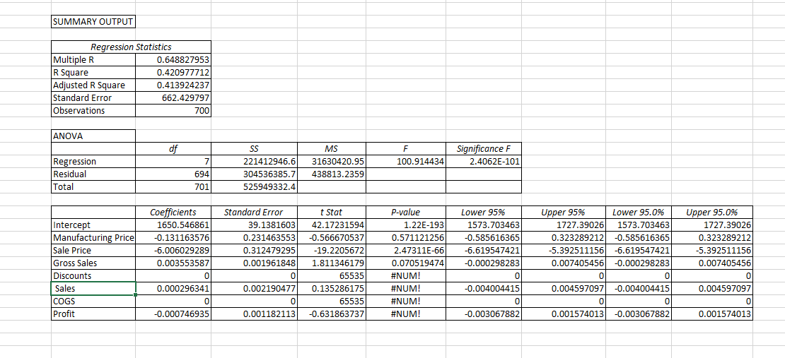
Statistical Analysis using Excel
Regression analysis performed on data that shows the relationship between two or more variables.

Slide 7
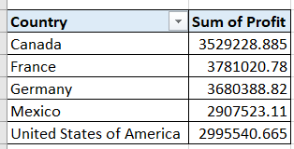
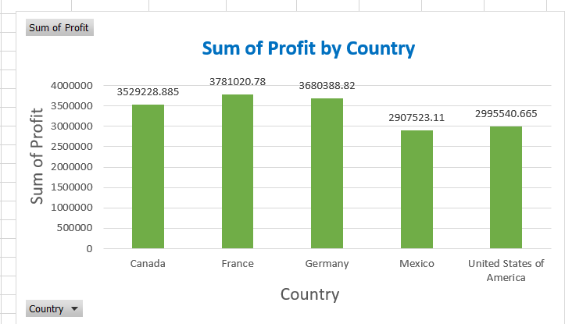
Graphical Analysis using Excel
The below graph shows Country wise Sum of profit .
By this graph we understand
France is the topmost country in
Profit.
Mexico has the Lowest Profit.

Slide 8
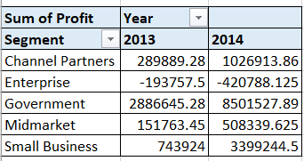
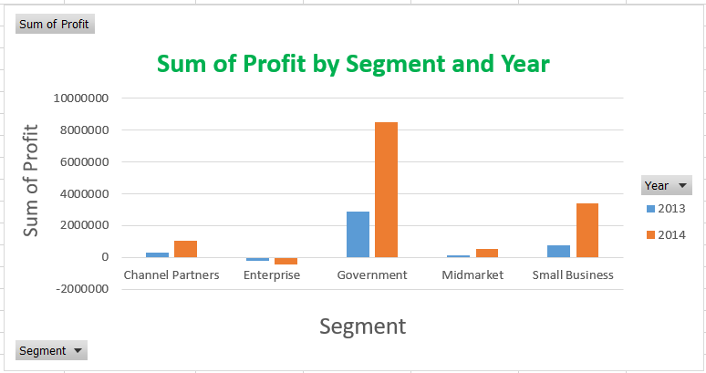
Graphical Analysis using Excel
The below graph shows Sum of profit by segment and year.
Government segment has the
Highest profit in 2013 .
Enterprise segment has the
Lowest profit in 2013 and 2014

Slide 9
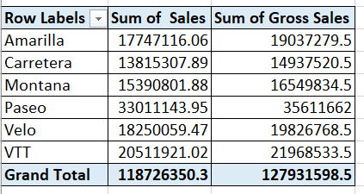
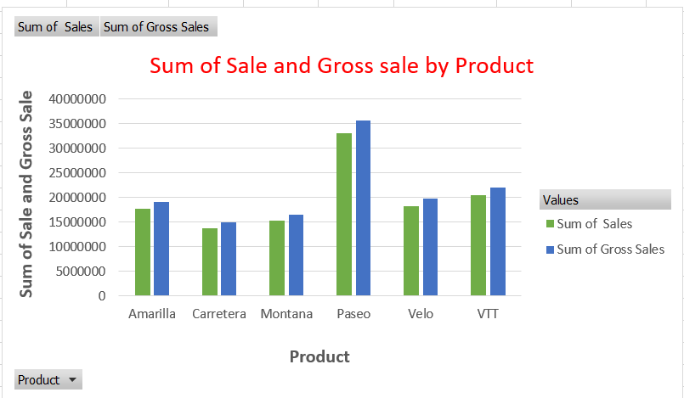
Graphical Analysis using Excel
The below graph shows Sum of sale and Gross sale by product.
Paseo has the highest sale and
Gross sale.
Carretera has the lowest sale and
Gross sale

Slide 10
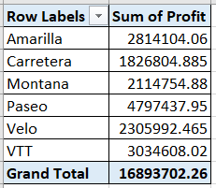
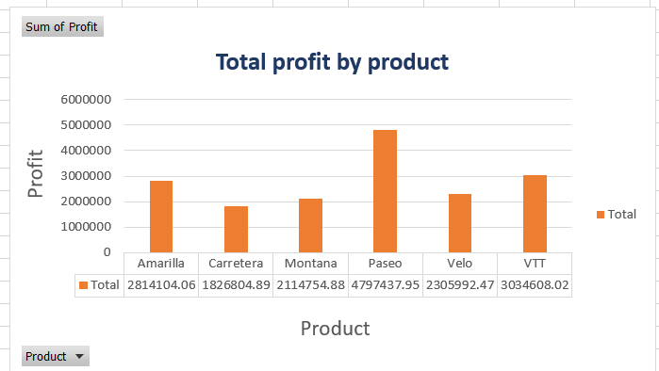
Graphical Analysis using Excel
The below graph shows Sum of profit by product.
Among all the products paseo
has the highest profit and Carretera
has lowest

Slide 11
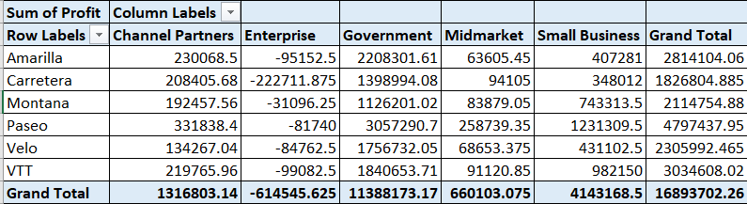
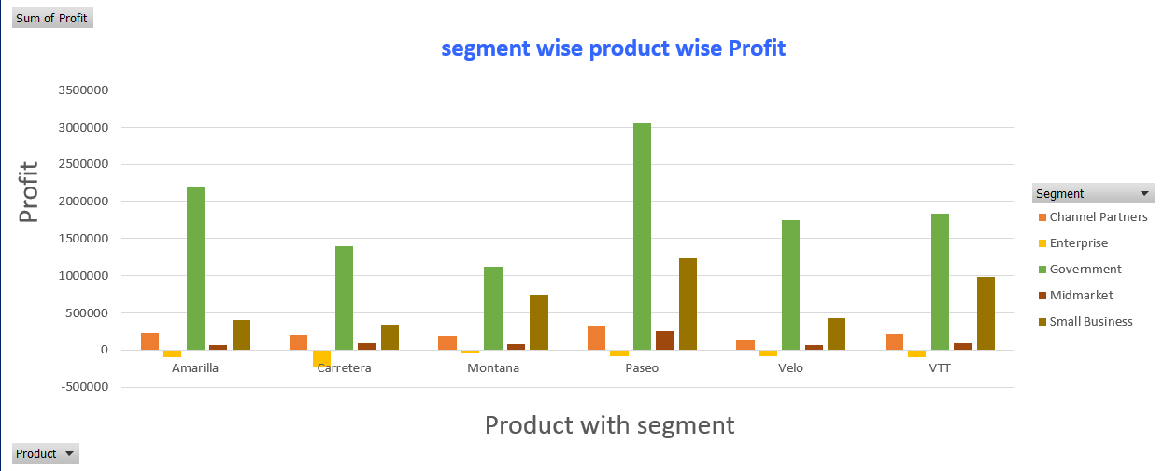
Graphical Analysis using Excel
The below graph shows Segment wise product wise
Profit.
Among all the products paseo
has the highest profit and Carretera
has lowest.
Overall Government Segment has the highest profit
And enterprise segment has the lowest profit.

Slide 12
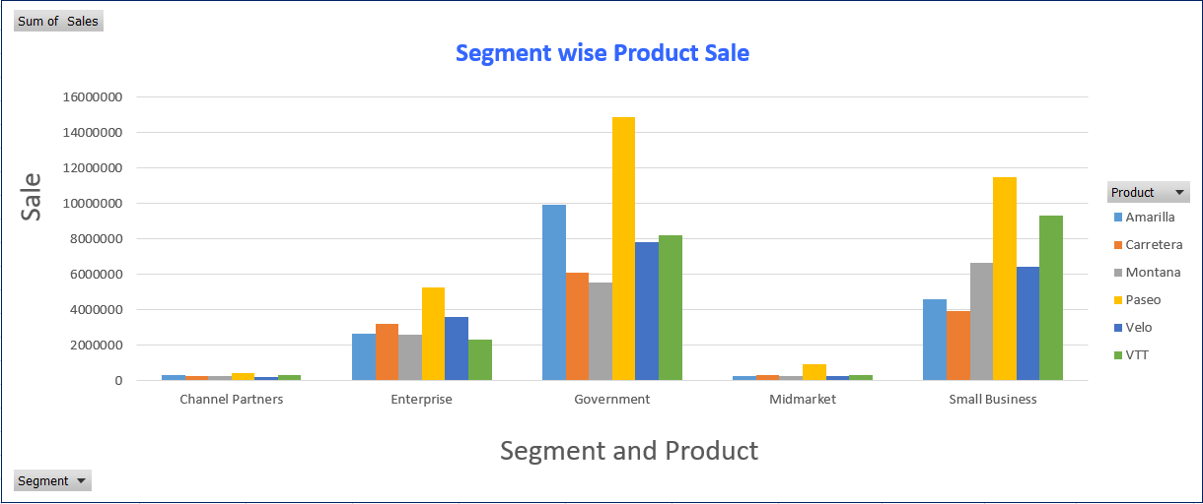
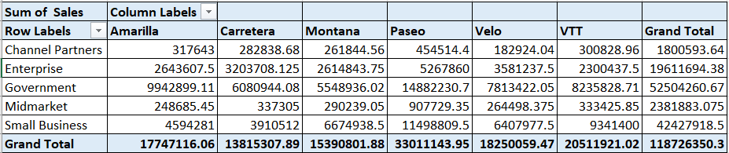
Graphical Analysis using Excel
The graph shows
Segment wise product Sale.
Among all the products
paseo has the highest sale
and Carretera has lowest
Sale.
Among all the segments
Government has the highest
sale and channel partner
has lowest sale.

Slide 13
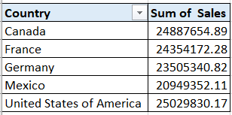
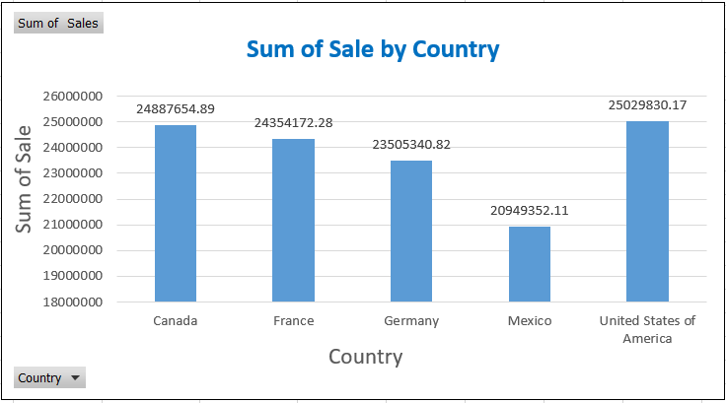
Graphical Analysis using Excel
The graph shows Sum of Sale by
Country.
USA has the highest Sale than other
Country and Mexico has the lowest sale.

Slide 14

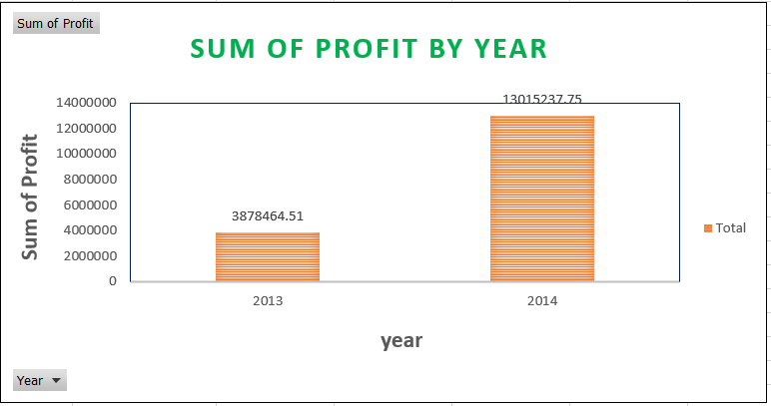
Graphical Analysis using Excel
The graph shows Sum of Profit by
Year.
2014 year has the highest profit
And 2013 year has lowest profit.

Slide 15
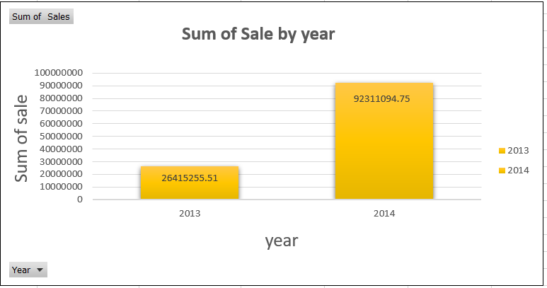

Graphical Analysis using Excel
The graph shows Sum of Sale by Year.
2014 year has the highest Sale
And 2013 year has lowest Sale.

Slide 16
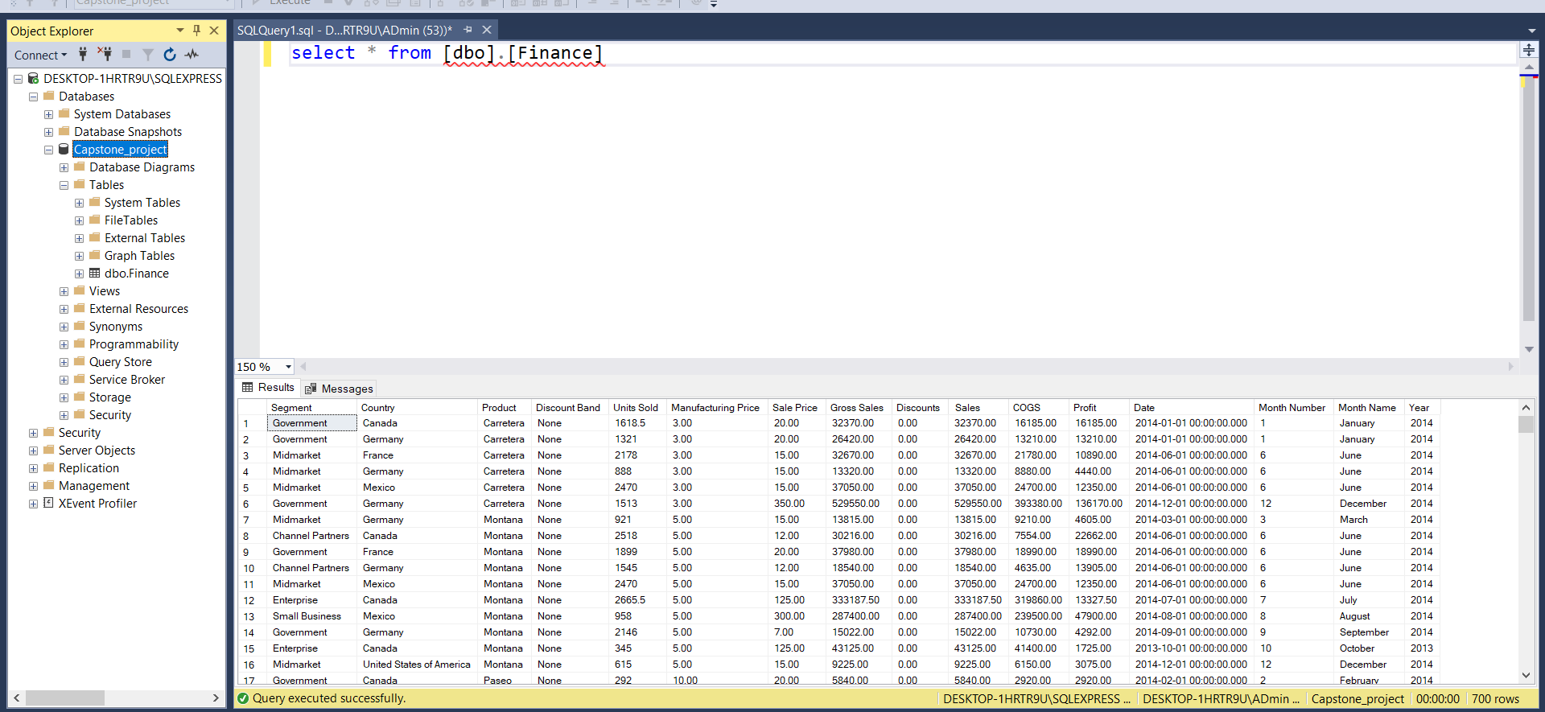
Insert the given data into the SQL server
Insert the relevant screenshots verifying that the data is successfully inserted into a SQL DB. Run a basic Queries on Data.

Slide 17
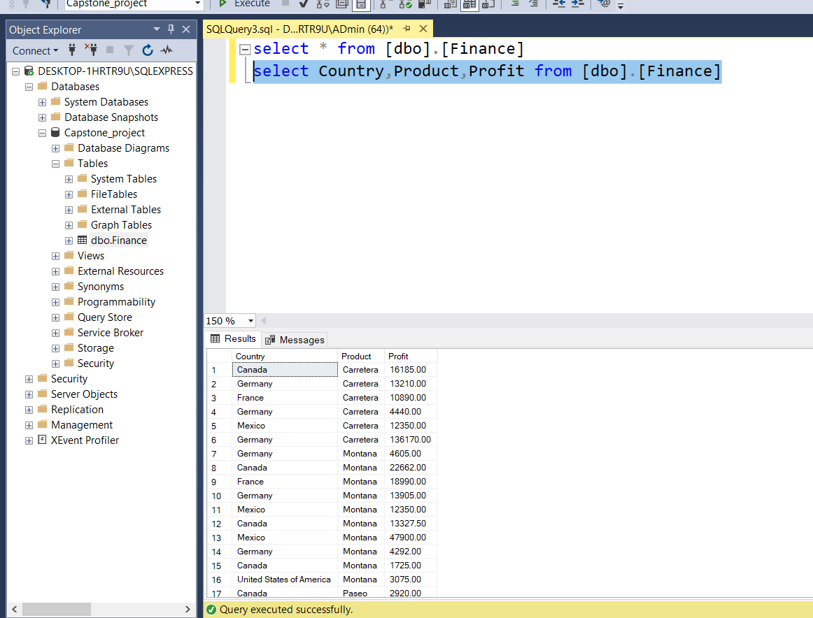
Insert the given data into the SQL server
Insert the relevant screenshots verifying that the data is successfully inserted into a SQL DB. Run a basic Queries on Data.

Slide 18
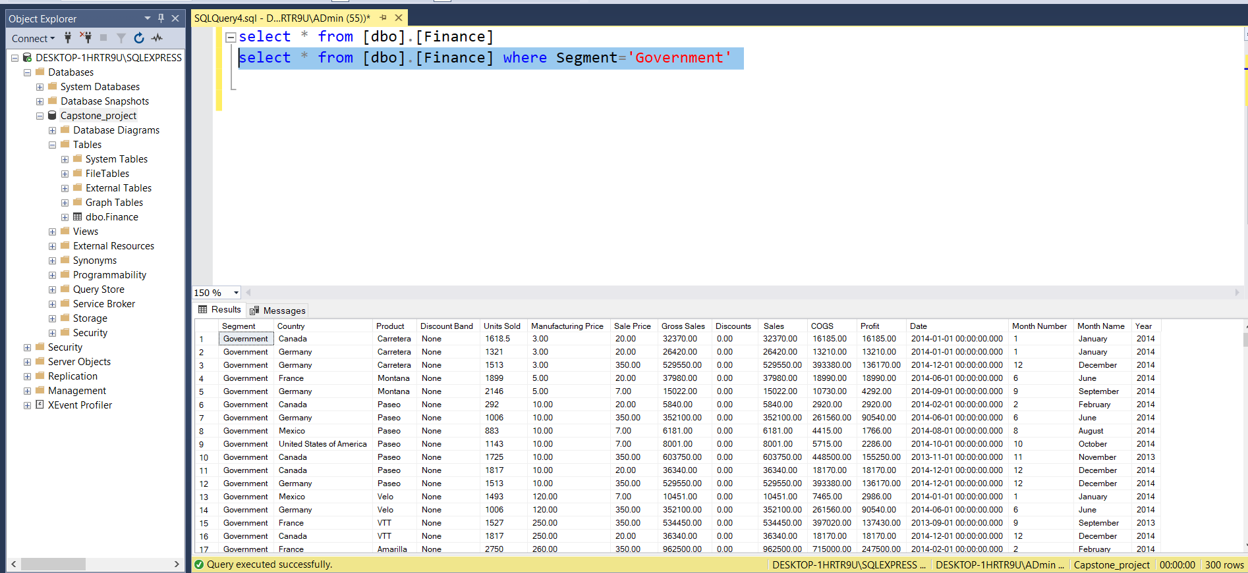
Insert the given data into the SQL server
Insert the relevant screenshots verifying that the data is successfully inserted into a SQL DB. Run a basic Queries on Data.

Slide 19
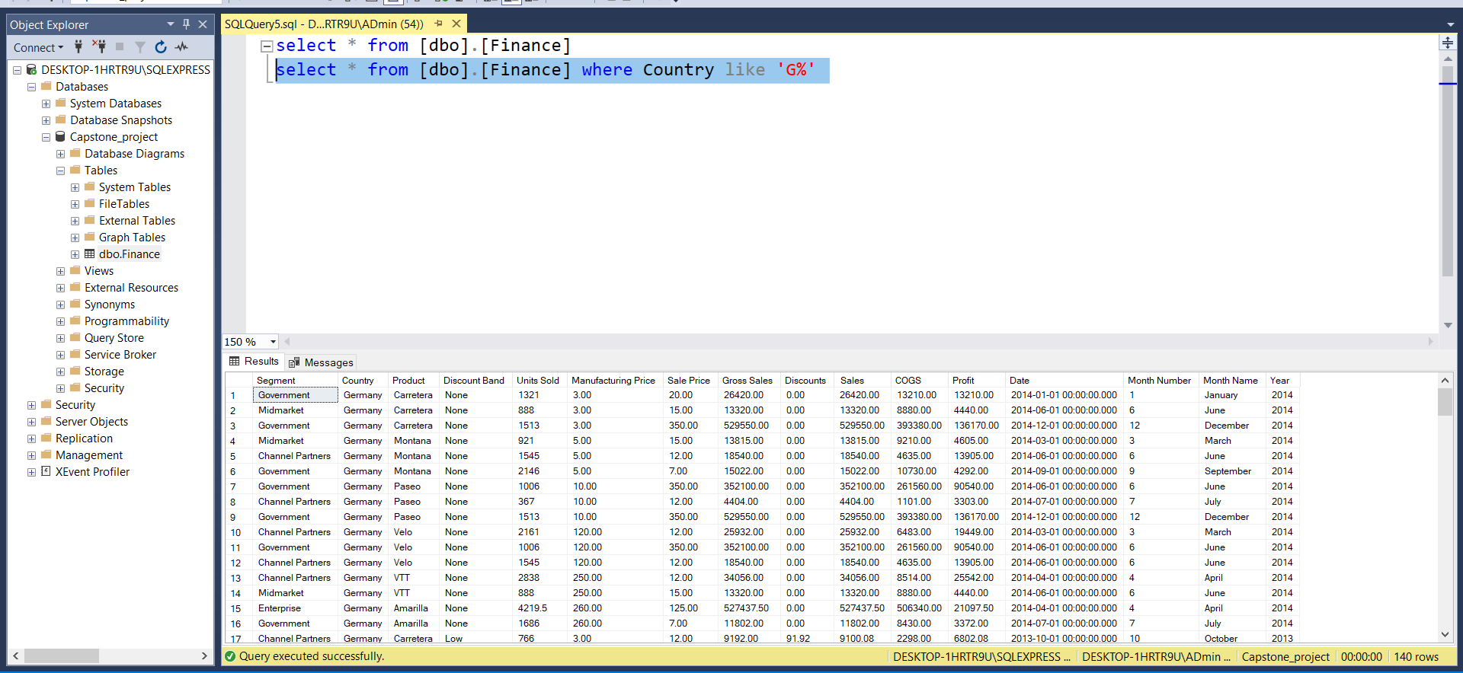
Insert the given data into the SQL server
Insert the relevant screenshots verifying that the data is successfully inserted into a SQL DB. Run a basic Queries on Data.

Slide 20
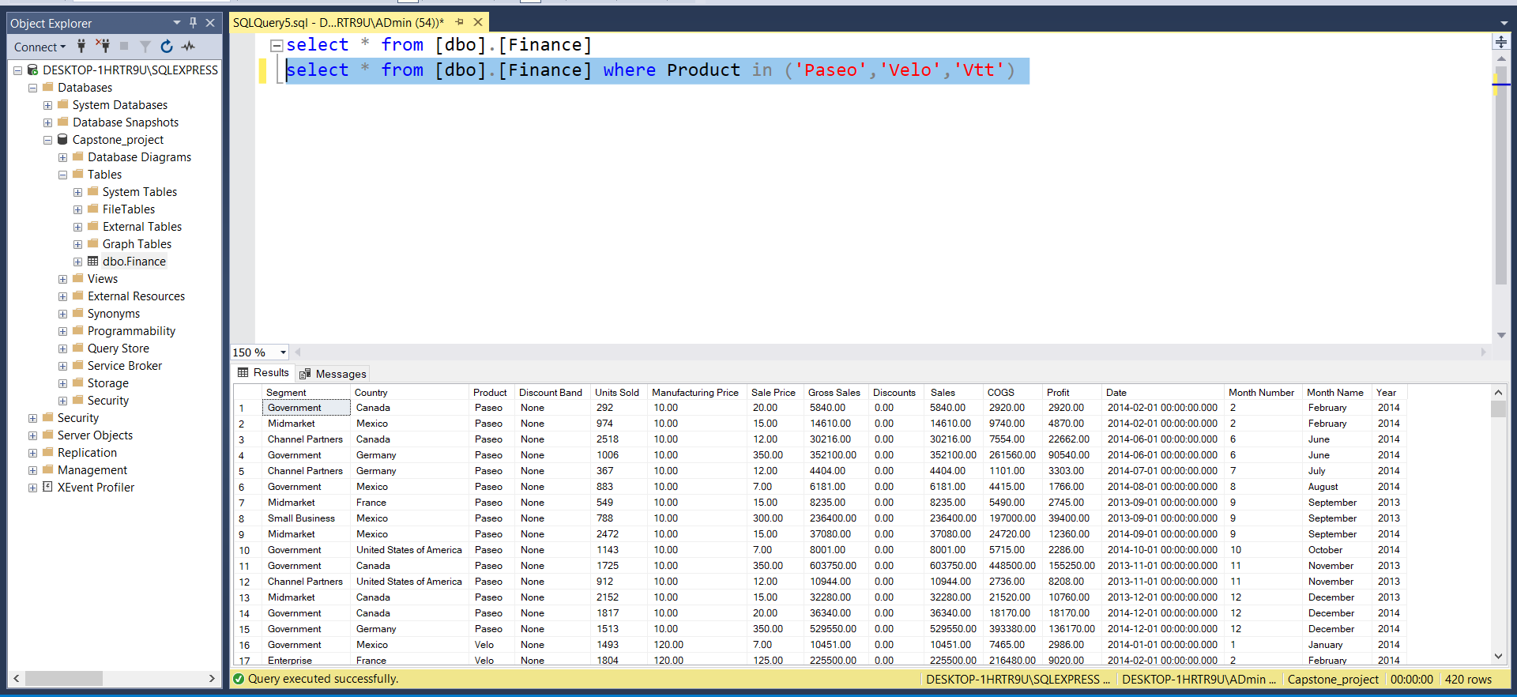
Insert the given data into the SQL server
Insert the relevant screenshots verifying that the data is successfully inserted into a SQL DB. Run a basic Queries on Data.

Slide 21
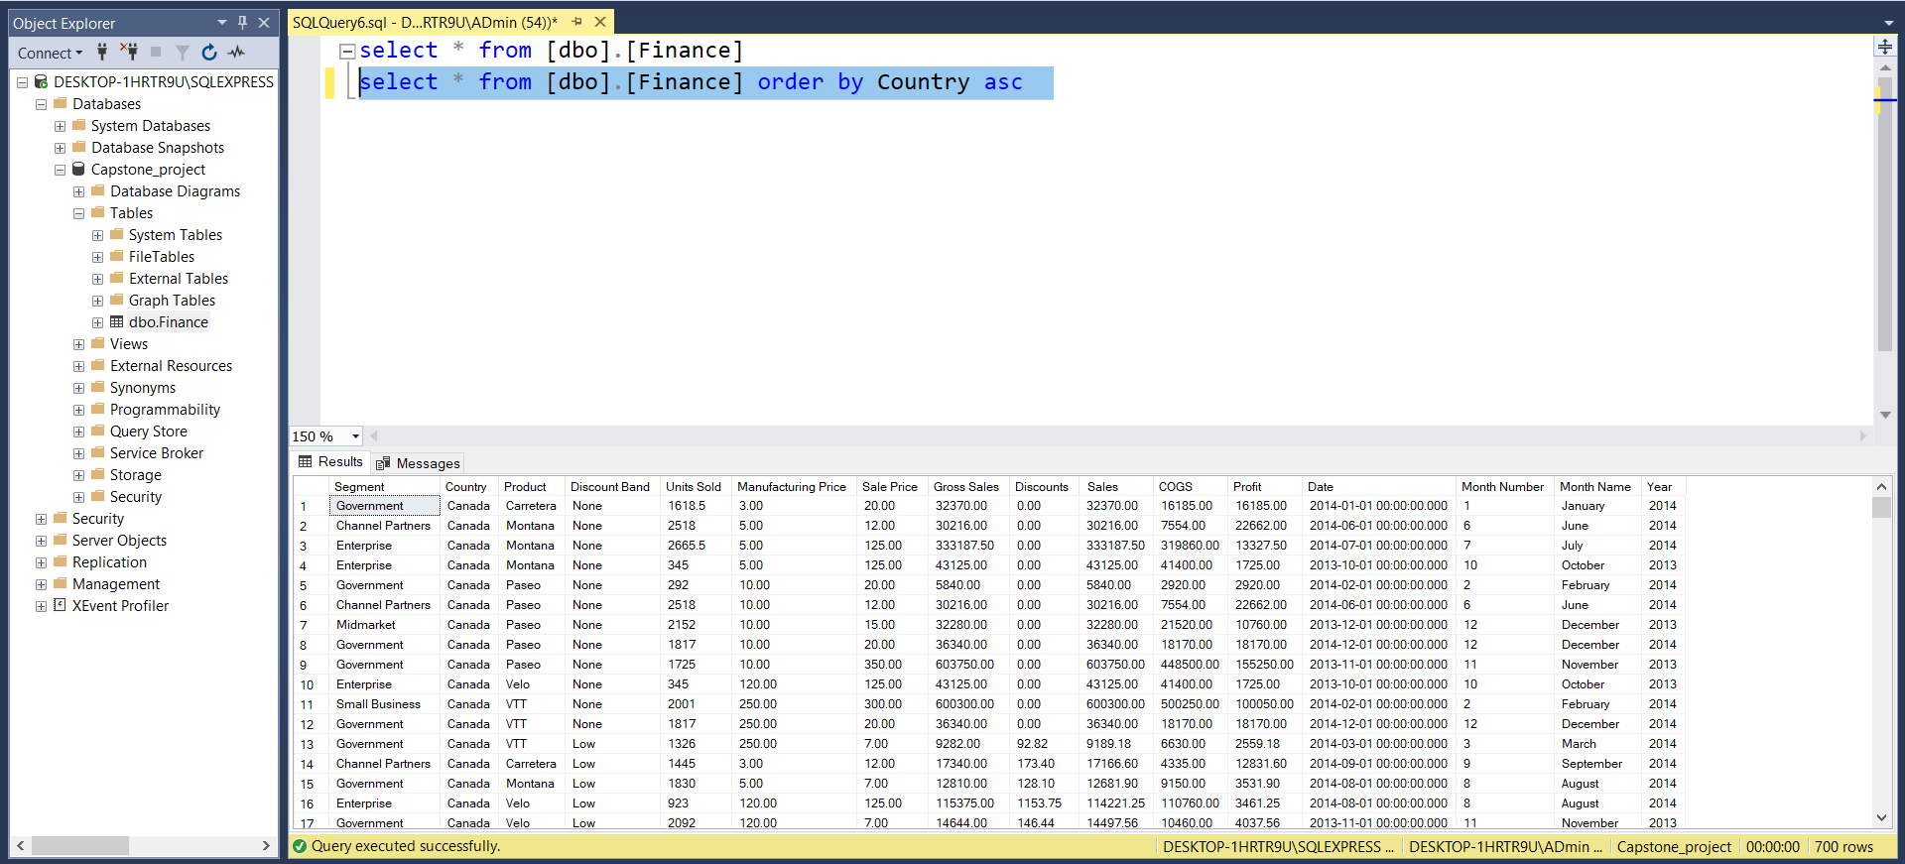
Insert the given data into the SQL server
Insert the relevant screenshots verifying that the data is successfully inserted into a SQL DB. Run a basic Queries on Data.

Slide 22
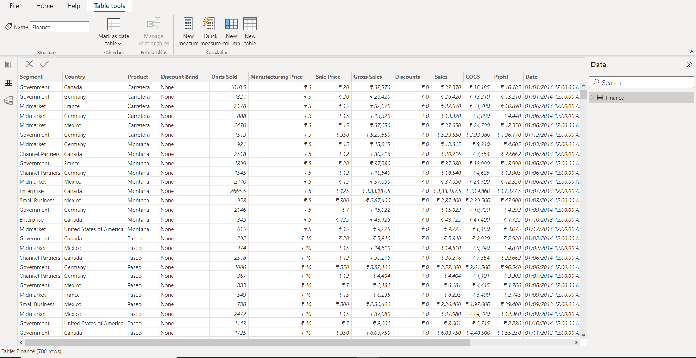
Import the Data from the SQL Database into PowerBI
(This is a dummy “about us” section)
Insert the relevant screenshots verifying that the data is successfully inserted into PowerBI and do the required data cleaning or creation of measured for data analysis

Slide 23
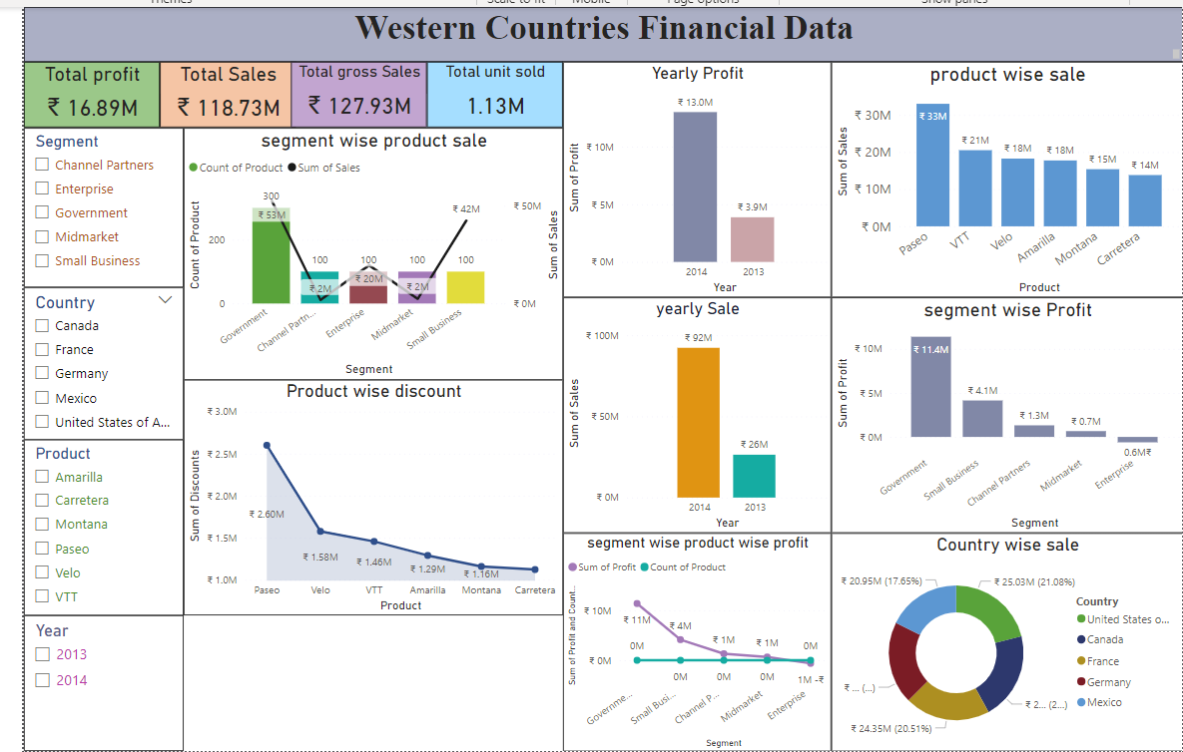
Interactive Dashboard by using visualization tools
(This is a dummy “about us” section)
Insert the relevant screenshots of the Dashboard made using Visualization tools such as PowerBi , Make a beautiful Dashboard that shows visually appealing graphs and data analysis.

Slide 24
Conclusion and Inferences
1. Descriptive statistics analyzes Mean, Standard Error, Median, Mode, Standard Deviation, Variance, Kurtosis, Skewness, Range, Minimum, Maximum, Sum, and Count.
2. France is the topmost country in Profit And Mexico has the Lowest Profit.
3. Government segment has the Highest profit in 2013 and Enterprise segment has the Lowest profit in 2013 and 2014.
4. Paseo has the highest sale and Gross sale. Carretera has the lowest sale and Gross sale.
5. Among all the products paseo has the highest profit and Carretera has lowest.
6. Among all the products paseo has the highest profit and Carretera has lowest. Overall Government Segment has the highest profit And enterprise segment has the lowest profit.
7. Among all the products paseo has the highest sale and Carretera has lowest Sale. Among all the segments Government has the highest sale and channel partner has lowest sale.
8. USA has the highest Sale than other Country and Mexico has the lowest sale.

Slide 25
Conclusion and Inferences
9. 2014 year has the highest profit And 2013 year has lowest profit.
10. 2014 year has the highest Sale And 2013 year has lowest Sale.
11. Top two countries are Canada and France.
12. Bottom three products are Carretera , Montana and Velo.

Slide 26
Endnotes
Reference Links:-
Western Countries Financial Data.xlsx
capstone project.pbix

